Slide 1
AI assisted Web Automation
CS221 Project
By- tachyon (Mohammad Mahbubuzzaman)
Vivkumar (Vivek Kumar)

Slide 2
Agenda
Motivation and Problem Definition
Approach and challenges
Results and Analysis
Ensemble and Results
Conclusion and Future work

Slide 3
Motivation and Problem Definition
Automate web browsing tasks with AI
Automate tasks like Login, search, scroll, zoom, pan
Automatic fill-up forms, download/upload of images
Current solutions are heavily dependent on system APIs
Our approach is to enable web browsing with user commands
Problem definition
Object detection and classification of GUI elements - scope of current project
Translation of user commands to sequence of tasks
An example of “Do Login” action generates sequence of tasks:
Recognize a “Login” button → Click a Login Button → Input username→ Input Password → Detect a successful or unsuccessful login

Slide 4
Challenges and Approach
The recognition of the GUI elements on website screen is a challenging task
diversity of UI designs and display screens
complexity and customization of GUI skeletons
Collect Representative dataset
Public dataset
Modification to Public dataset - mislabel, under-representation, too few data
Identify correct Model Architecture
Object detection and classification for small, medium and large size objects
One stage vs two stage detectors
Fine tuning with Yolov5s model and hyperparameters
Explore, Experiment and understand with Yolov5l6
Explore, Experiment and understand with Faster-RCNN
Ensemble detection outputs from two or more AI models

Slide 5
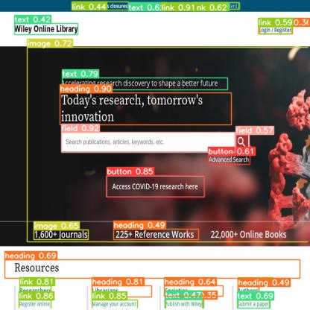
Results & Analysis
Categorization of classes
Heading
Button
Field
Text
Image
Iframe
Link
Label
Evaluation - mAP@0.5 and mAP@0.5:0.95

Slide 6
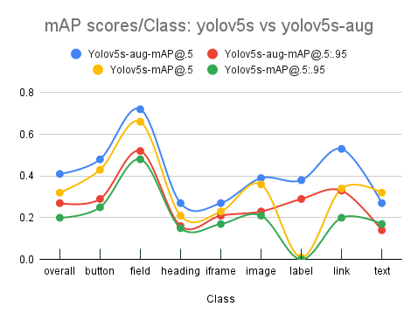
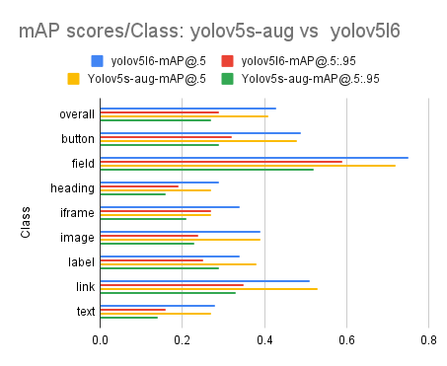
Results & Analysis continued
Fig1: yolov5s model on original dataset vs Augmented dataset
Fig2: yolov5s vs yolov5l6 comparison on mAP scores

Slide 7
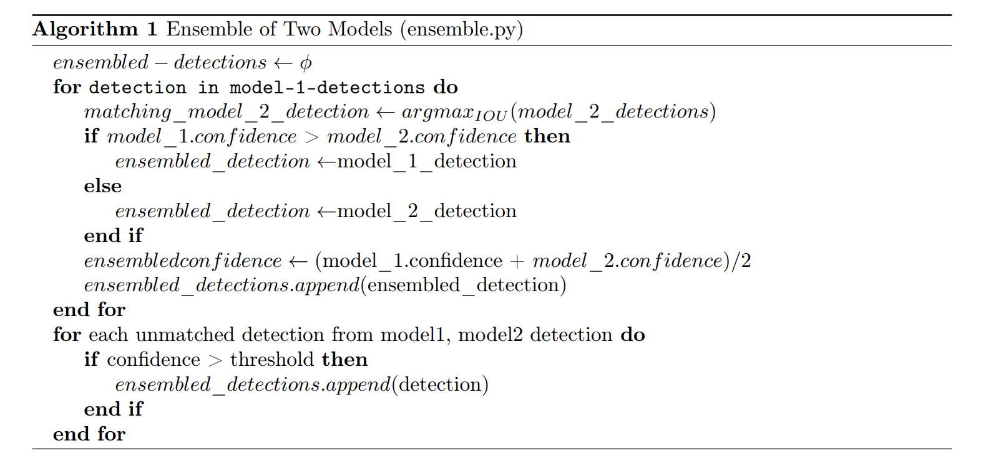
Ensemble & Results

Slide 8
Conclusion and Future work
Ensemble gives better prediction output than any individual model
Training and Fine-tuning of One-stage detector models like Faster-RCNN and CenterDet
Analysis of object size vs model topology
Proportional weightage for individual models in Ensemble
Enhancement in Dataset by adding representative synthetic data
Model | mAP @ 0.5
YOLOv5s | 25%
YOLOv5l6 | 28%
Ensemble (Our model) | 31.5%

